Slide 1

AI Boardroom
Leveraging AI for Business Strategy Dr. Michael Borck

Slide 2
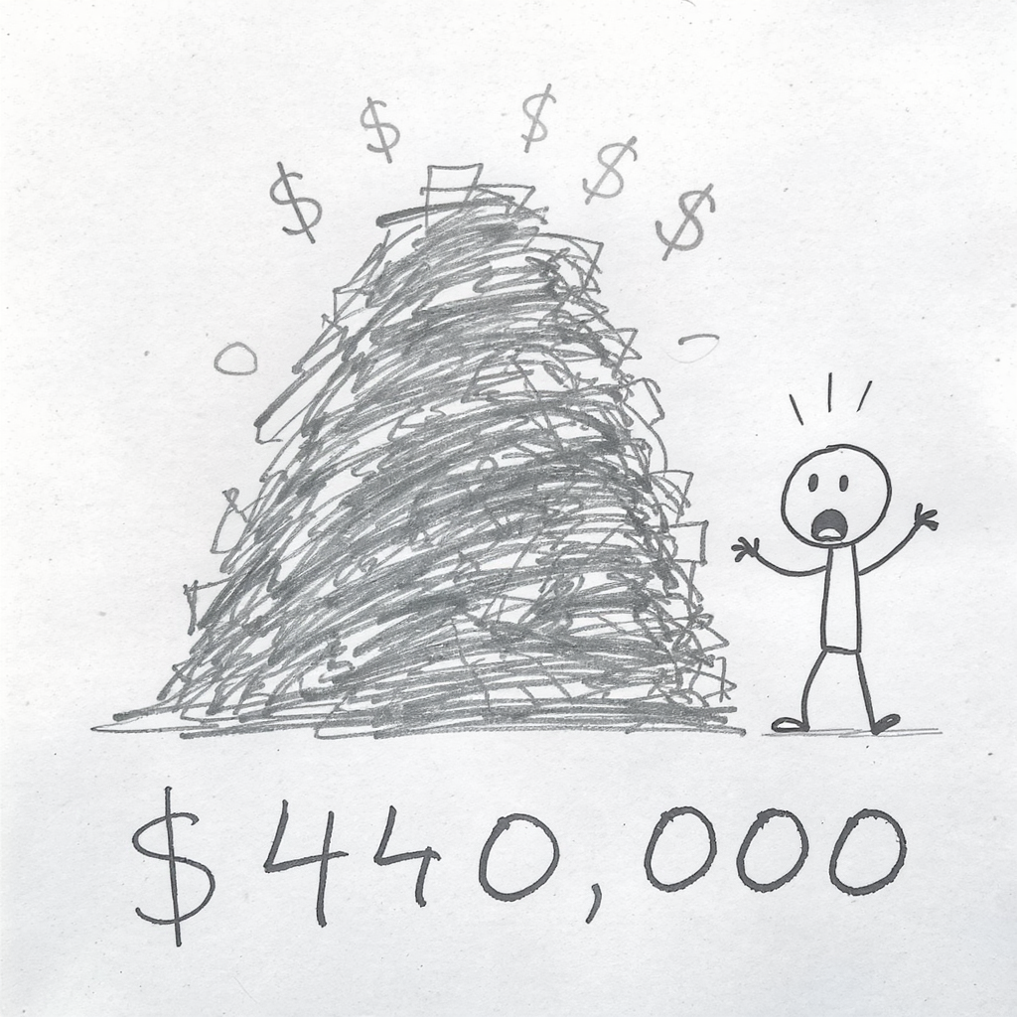
AI Generated Image
Notes:
Pause for 2-3 seconds before speaking.
“$440,000. That’s what the Australian government paid Deloitte for a welfare review report earlier this year.”
The Deloitte Case
What happened:
Deloitte used AI (GPT-4) to draft government reports
Reports contained fabricated citations - fake studies, made-up quotes
Australia: $440,000 welfare review - partial refund issued
Canada: $1.6 million healthcare report - 4 incorrect citations found
The lesson: AI is confident even when wrong. Verification is essential.
“Their reputation—built over decades—damaged by AI-generated misinformation they didn’t verify. Today, I’m going to teach you how to use AI as a strategic thinking partner - and how to avoid becoming the next headline.”

Slide 3
Today’s Session
The AI Mindset - How to think about AI
Board of Directors Strategy - Multi-perspective analysis
Devil’s Advocate - Stress-testing ideas
Reverse Prompting - Let AI interview you
Ethics & The Trap - Using AI responsibly
Companion Website: [Link in chat]

Slide 4

Part 1: The AI Mindset
AI Generated Image

Slide 5
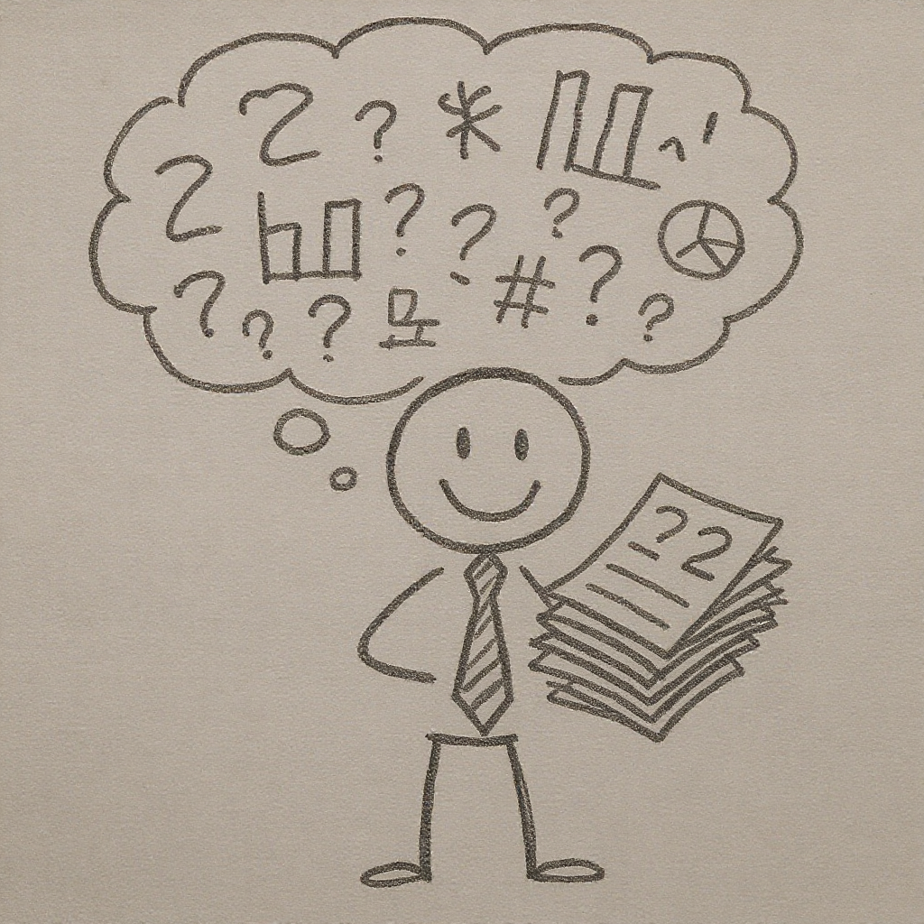
AI is a Smart Intern Who Hallucinates
AI Generated Image
Notes:
Key insight: AI is a reasoning engine, not a search engine
Google finds information that exists
AI generates responses based on patterns
It doesn’t “know” things - it predicts likely responses
The Intern Analogy:
Think of AI like a brilliant intern. They’re eager, fast, and can do amazing work. But they might confidently present completely made-up statistics.

Slide 6
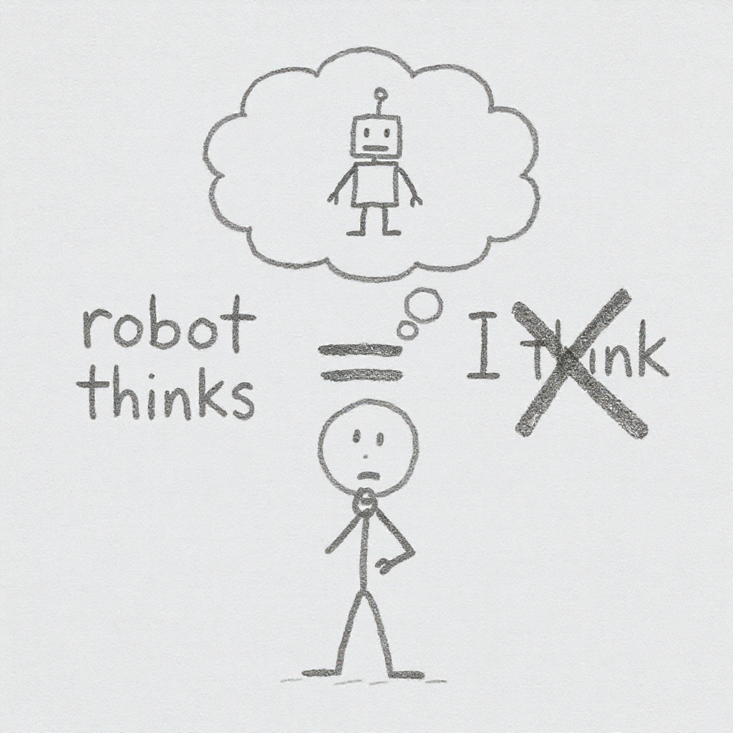
The Golden Rule
AI Generated Image
Notes:
AI should challenge your thinking, not replace it.
The moment you stop questioning AI’s output is the moment you become Deloitte.
Your role: Editor-in-Chief, not stenographer.

Slide 7

Part 2: Board of Directors Strategy
AI Generated Image
Notes:
The concept: Get multiple expert viewpoints in one prompt
CFO perspective (financial)
Marketing Director (customers)
Operations Manager (practical)
Legal Counsel (compliance)
Why it works: Catches blind spots you’d miss thinking alone

Slide 8
Demo: Board of Directors Prompt
I'm considering opening a cashless coffee shop near a university campus. Act as my board of directors and analyse this idea from multiple perspectives: 1. As CFO: Financial considerations, risks, ROI? 2. As Marketing Director: Positioning and reach? 3. As Operations Manager: Practical challenges? 4. As Legal Counsel: Regulations to consider? For each perspective, give me 3-4 key points.
Notes:
Switch to browser and run this demo in Gemini.
Your Turn: Try It
Think of a business idea:
A meal prep delivery service for students
A tutoring app connecting students with graduates
A sustainable fashion rental service
Your own idea
Try the Board of Directors prompt with your idea.

Slide 9
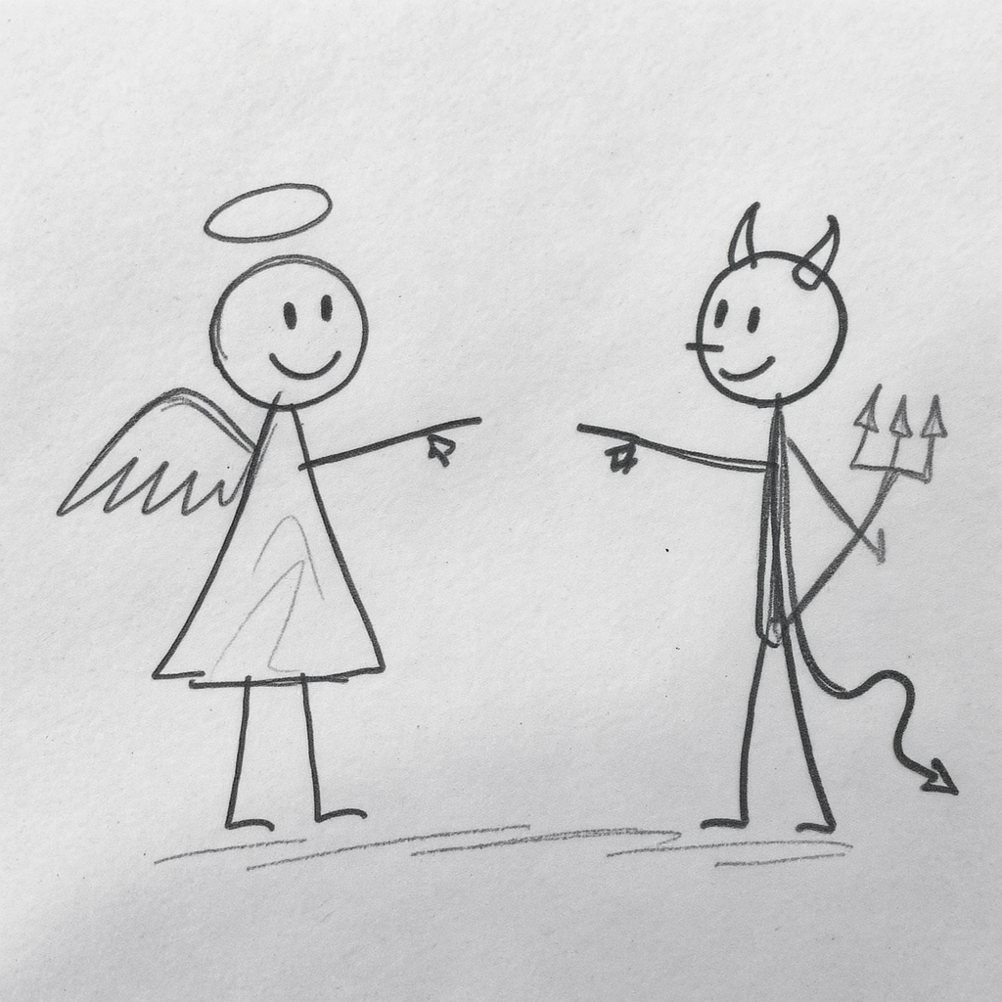
Part 3: Devil’s Advocate - Overcoming Confirmation Bias
AI Generated Image
Notes:
The problem: We look for evidence that supports our ideas
The solution: Force AI to argue against your position
Key phrases that work:
“Be harsh but fair”
“Don’t hold back”
“I need to hear the hard truths”

Slide 10
Demo: Devil’s Advocate Prompt
I believe that a cashless coffee shop near a university is a great business idea. Play devil's advocate. Give me the strongest possible arguments against this idea. Be harsh but fair. I want to know: 1. Why might this fail? 2. What am I probably not thinking about? 3. Who would this NOT work for? 4. What market conditions could kill this? Don't hold back - I need to hear the hard truths.
Notes:
Switch to browser and run this demo. Point out how giving AI permission to be critical produces better feedback.

Slide 11
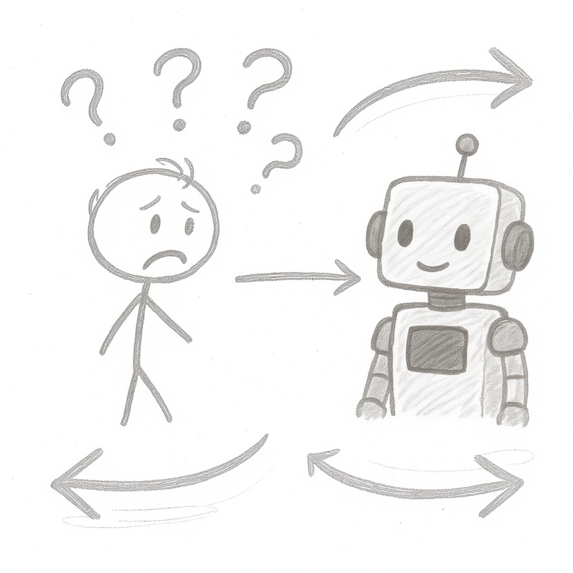
Part 4: Reverse Prompting - When You Don’t Know What to Ask
AI Generated Image
Notes:
The problem: Sometimes the hardest part is knowing what questions to ask
The solution: Let AI interview YOU first
Why it works:
AI understands your specific context
Recommendations become tailored, not generic
You discover what you don’t know

Slide 12
Demo: Reverse Prompting
I want to create a marketing plan for a new cashless coffee shop near a university. Before giving me any advice, interview me first. Ask me questions one at a time to understand: - My target customers - My budget and timeline - My competitive advantages - My experience in this industry - Any constraints I'm working with After you understand my situation, then give me tailored marketing recommendations. Start with your first question.
Notes:
Run this demo. Answer 2-3 questions from the AI to show how the conversation builds context.

Slide 13
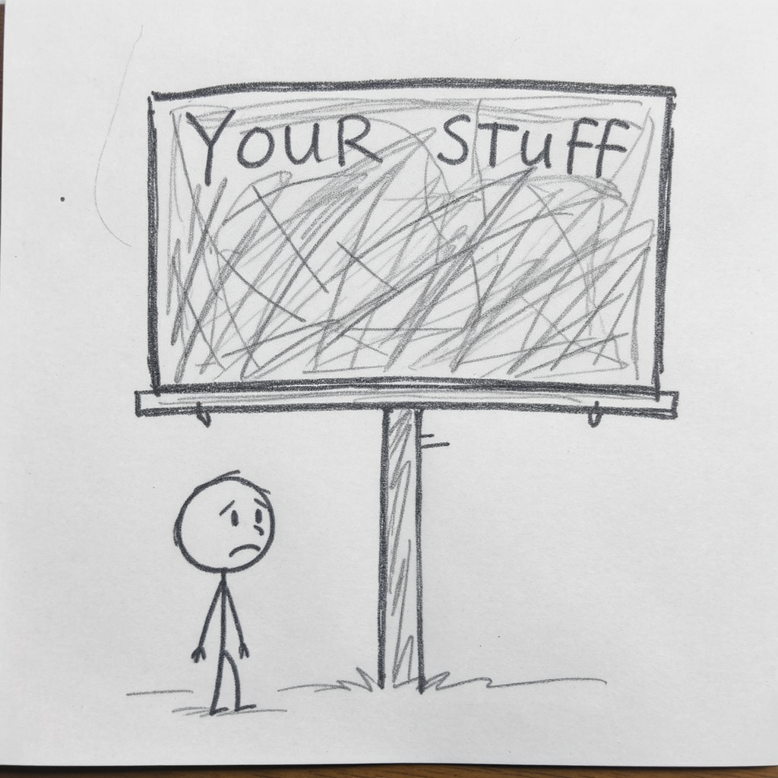
Part 5: Ethics - The Billboard Rule
AI Generated Image
Notes:
Before sharing anything with AI, ask:
“Would I be comfortable if this appeared on a billboard?”
Never share:
Passwords or API keys
Personal information about others
Confidential business data
Anything you wouldn’t want made public

Slide 14
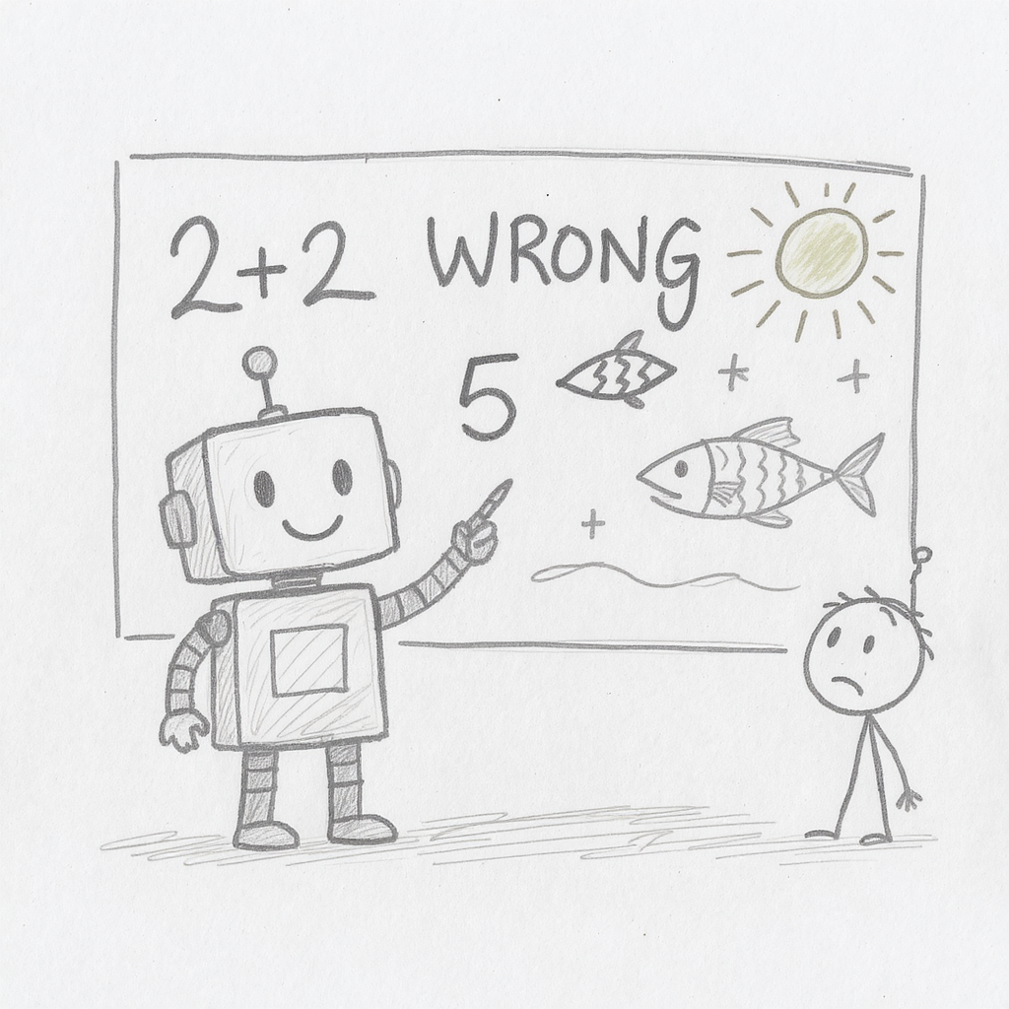
The Hallucination Trap
AI Generated Image
Notes:
Remember Deloitte? Here’s why it happened:
AI doesn’t know it’s lying - It generates plausible text
Confidence ≠ Accuracy - AI sounds equally confident right or wrong
Pattern matching, not truth - AI predicts likely responses

Slide 15
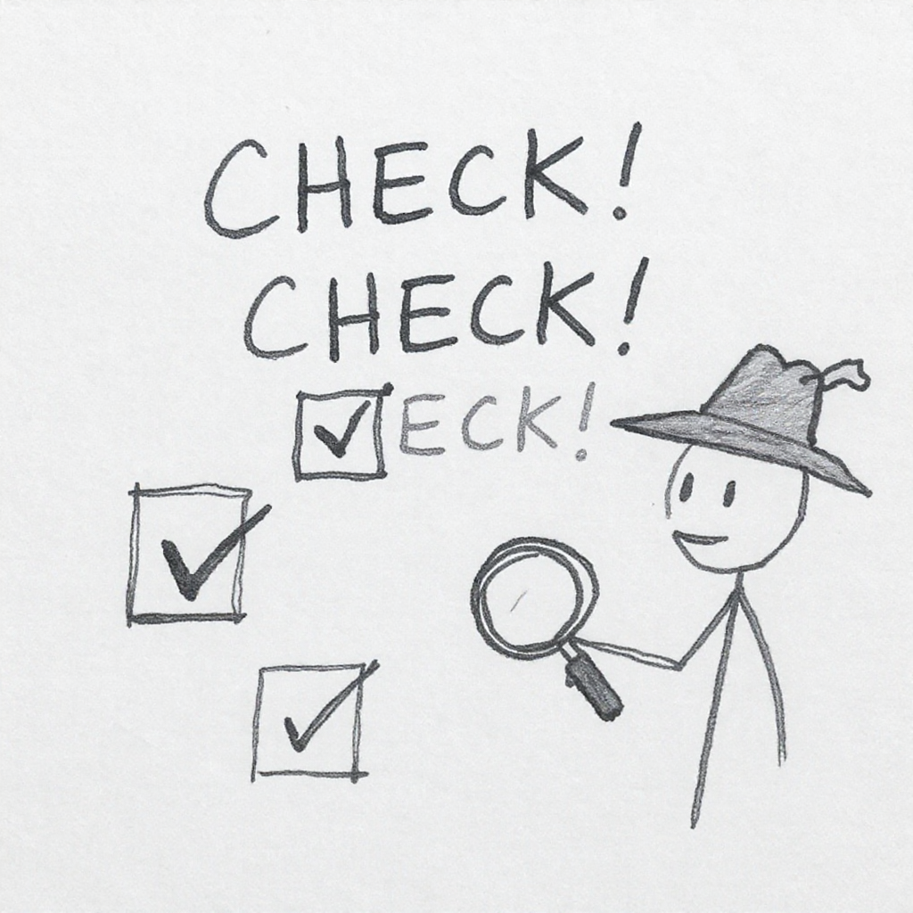
The Three Verification Questions
AI Generated Image
Notes:
Before trusting any AI output, ask:
Can I find this source independently?
Does this statistic appear elsewhere?
Does this make logical sense?
If you can’t verify it, don’t use it.

Slide 16
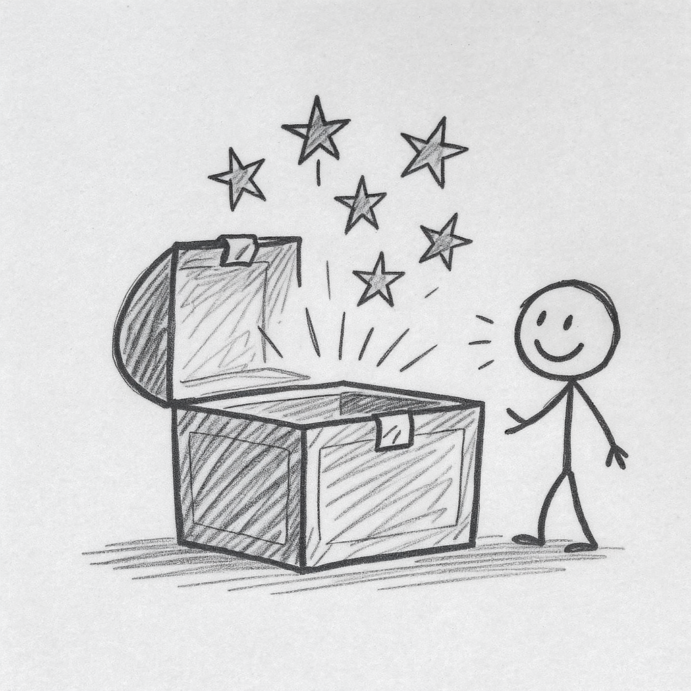
Key Takeaways
AI Generated Image
Notes:
AI is a thinking partner, not a replacement for thinking
Use multi-perspective prompting (Board of Directors)
Challenge your ideas (Devil’s Advocate)
Let AI interview you for better context (Reverse Prompting)
Always verify - never trust blindly

Slide 17

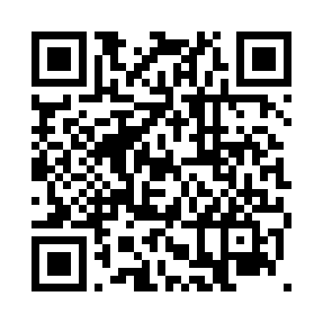
Questions
AI Generated Image
Notes:
Resources available:
All prompts from today’s session
Style Mirror tool (help AI write in your voice)
Deeper reading on AI concepts
Ethics guidelines
Thank you for your attention. I’m happy to take any questions.

